Slide 1
Three Equilateral Triangles
Provenance unknown

Slide 2


Three Equilateral Triangles
The shaded triangles are all equilateral.
The exact areas of two triangles are given.
What is the exact sum of the areas of the other two triangles?
(NOT to scale)
$$81\sqrt{3}$$
$$36\sqrt{3}$$

Slide 3




Three Equilateral Triangles
$$18$$
$$12$$
$$6$$
$$9$$

Slide 4
Three Equilateral Triangles
$$18$$
$$12$$
$$6$$
$$9$$

Slide 5
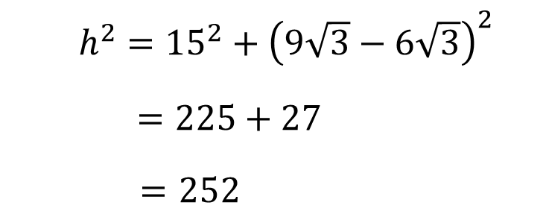


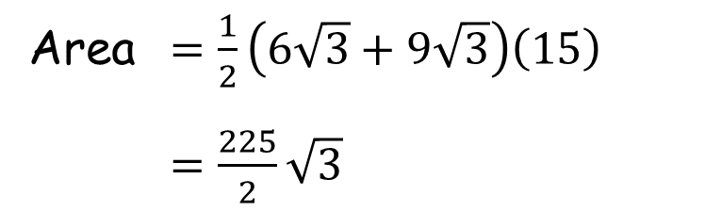


Three Equilateral Triangles
Area $=\frac{1}{2}\left(6\sqrt{3}+9\sqrt{3}\right)\left(15\right)$
$=\frac{225}{2}\sqrt{3}$
$h^{2}={15}^{2}+{\left(9\sqrt{3}−6\sqrt{3}\right)}^{2}$
$=225+27$
$=252$
$$h$$
$$9\sqrt{3}$$
$$6\sqrt{3}$$
$$15$$

Slide 6

Area $=\frac{1}{2}h\frac{\sqrt{3}}{2}h$
$=\frac{1}{2}\left(252\right)\frac{\sqrt{3}}{2}$
$=\frac{252}{4}\sqrt{3}$
$$h$$

Slide 7

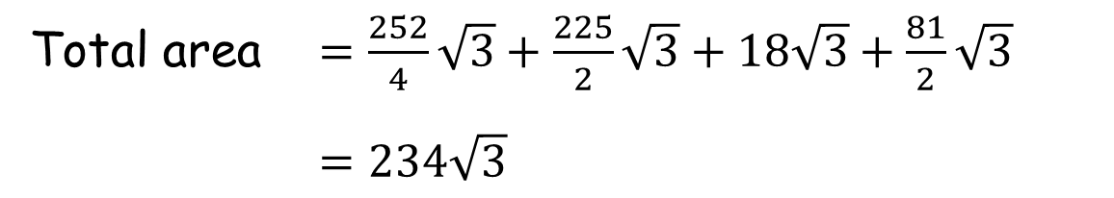



Three Equilateral Triangles
SIC_8x
Total area $=\frac{252}{4}\sqrt{3}+\frac{225}{2}\sqrt{3}+18\sqrt{3}+\frac{81}{2}\sqrt{3}$
$=234\sqrt{3}$
$$\frac{252}{4}\sqrt{3}$$
$$\frac{225}{2}\sqrt{3}$$
$$\frac{81}{2}\sqrt{3}$$
$$18\sqrt{3}$$

Slide 8

Three Equilateral Triangles
Note that the unknown area equals the known area!
Can you prove it?
$$36\sqrt{3}+81\sqrt{3}$$
$$81\sqrt{3}$$
$$36\sqrt{3}$$

Slide 9








$A=\sqrt{3}a^{2}$; $B=\sqrt{3}b^{2}$; $C=\sqrt{3}c^{2}$
$$C$$
$$2c$$
$$D$$
$$B$$
$$A$$
$$2a$$
$$2b$$

Slide 10
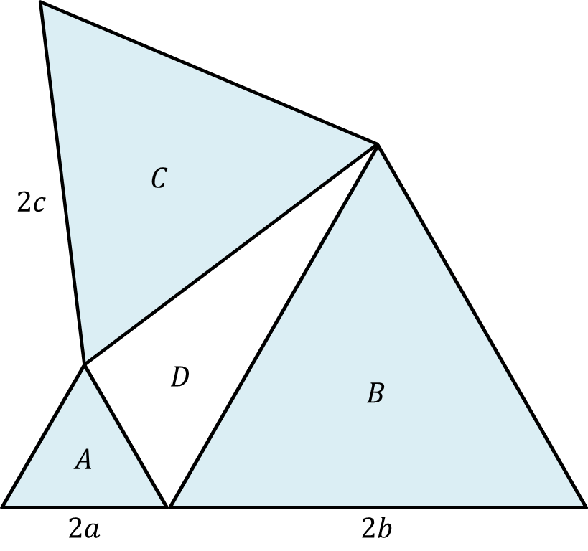

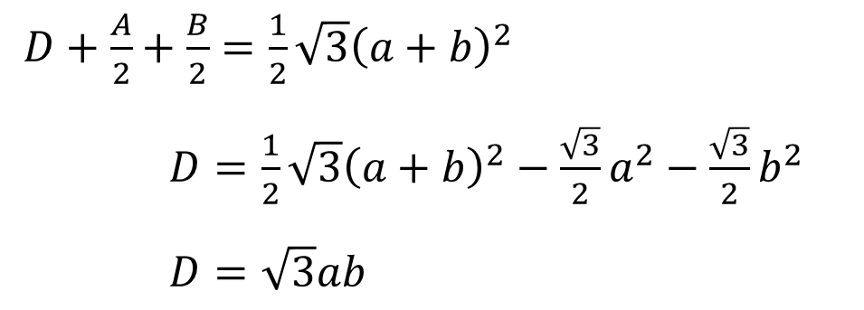







$D+\frac{A}{2}+\frac{B}{2}=\frac{1}{2}\sqrt{3}{\left(a+b\right)}^{2}$
$D=\frac{1}{2}\sqrt{3}{\left(a+b\right)}^{2}−\frac{\sqrt{3}}{2}a^{2}−\frac{\sqrt{3}}{2}b^{2}$
$D=\sqrt{3}ab$
$$C$$
$$\sqrt{3}b$$
$$\frac{1}{2}\sqrt{3}{\left(a+b\right)}^{2}$$
$$\frac{B}{2}$$
$$\frac{A}{2}$$
$$\sqrt{3}a$$
$$a$$
$$a+b$$
$$b$$

Slide 11

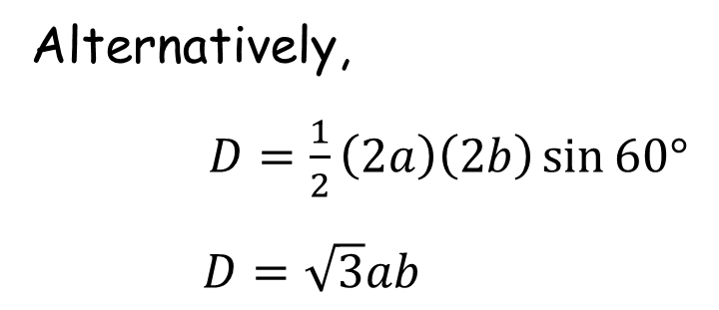
$D+\frac{A}{2}+\frac{B}{2}=\frac{1}{2}\sqrt{3}{\left(a+b\right)}^{2}$
$D=\frac{1}{2}\sqrt{3}{\left(a+b\right)}^{2}−\frac{\sqrt{3}}{2}a^{2}−\frac{\sqrt{3}}{2}b^{2}$
$D=\sqrt{3}ab$
$$C$$
Alternatively,
$D=\frac{1}{2}\left(2a\right)\left(2b\right)\sin{60°}$
$D=\sqrt{3}ab$
$$\sqrt{3}ab$$
$$B$$
$$A$$

Slide 12


${\left(2c\right)}^{2}={\left(a+b\right)}^{2}+{\left[\sqrt{3}\left(b−a\right)\right]}^{2}$
$4c^{2}=4a^{2}+4b^{2}−4ab$
$c^{2}=a^{2}−ab+b^{2}$
$C=\sqrt{3}a^{2}−\sqrt{3}ab+\sqrt{3}b^{2}$
$C=A−\sqrt{3}ab+B$
$$C$$
$$2c$$
$$\sqrt{3}b$$
$$\sqrt{3}a$$
$$a+b$$

Slide 13


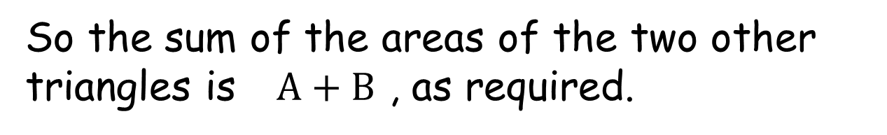
So the sum of the areas of the two other triangles is $A+B$ , as required.
$$A−\sqrt{3}ab+B$$
$$A+B$$
$$\sqrt{3}ab$$
$$B$$
$$A$$

Slide 15
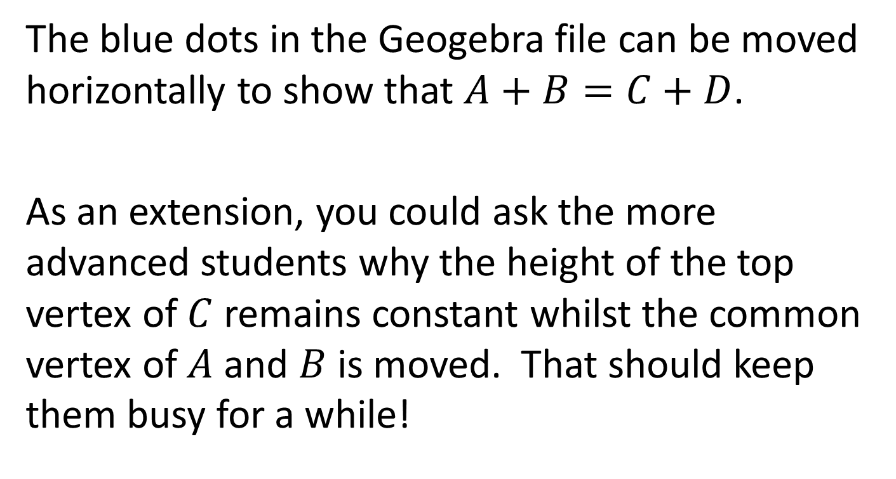
Note to Teacher
The blue dots in the Geogebra file can be moved horizontally to show that $A+B=C+D$.
As an extension, you could ask the more advanced students why the height of the top vertex of $C$ remains constant whilst the common vertex of $A$ and $B$ is moved. That should keep them busy for a while!

Slide 16
RESOURCES

Slide 17


Three Equilateral Triangles
SIC_81
The shaded triangles are all equilateral.
The exact areas of two triangles are given.
What is the exact sum of the areas of the other two triangles?
(NOT to scale)
$$9\sqrt{3}$$
$$\sqrt{3}$$

Slide 18

Three Equilateral Triangles
SIC_81
The shaded triangles are all equilateral.
The exact areas of two triangles are given.
What is the exact sum of the areas of the other two triangles?
(NOT to scale)
$$81\sqrt{3}$$
$$9\sqrt{3}$$

Slide 19


Three Equilateral Triangles
SIC_81
The shaded triangles are all equilateral.
The exact areas of two triangles are given.
What is the exact sum of the areas of the other two triangles?
(NOT to scale)
$$64\sqrt{3}$$
$$16\sqrt{3}$$

Slide 20


Three Equilateral Triangles
SIC_81
The shaded triangles are all equilateral.
The exact areas of two triangles are given.
What is the exact sum of the areas of the other two triangles?
(NOT to scale)
$$36\sqrt{3}$$
$$4\sqrt{3}$$

Slide 21

Three Equilateral Triangles
SIC_81
The shaded triangles are all equilateral.
The exact areas of two triangles are given.
What is the exact sum of the areas of the other two triangles?
(NOT to scale)
$$49\sqrt{3}$$
$$\sqrt{3}$$

Slide 22

Three Equilateral Triangles
SIC_81
The shaded triangles are all equilateral.
The exact areas of two triangles are given.
What is the exact sum of the areas of the other two triangles?
(NOT to scale)
$$81\sqrt{3}$$
$$49\sqrt{3}$$

Slide 23


Three Equilateral Triangles
SIC_81
The shaded triangles are all equilateral.
The exact areas of two triangles are given.
What is the exact sum of the areas of the other two triangles?
(NOT to scale)
$$16\sqrt{3}$$
$$4\sqrt{3}$$

Slide 24

Three Equilateral Triangles
SIC_81
The shaded triangles are all equilateral.
The exact areas of two triangles are given.
What is the exact sum of the areas of the other two triangles?
(NOT to scale)
$$16\sqrt{3}$$
$$9\sqrt{3}$$

Slide 25


Three Equilateral Triangles
SIC_81
The shaded triangles are all equilateral.
The exact areas of two triangles are given.
What is the exact sum of the areas of the other two triangles?
(NOT to scale)
$$4\sqrt{3}$$
$$\sqrt{3}$$

Slide 26
Three Equilateral Triangles
SIC_81
The shaded triangles are all equilateral.
The exact areas of two triangles are given.
What is the exact sum of the areas of the other two triangles?
(NOT to scale)
$$36\sqrt{3}$$
$$9\sqrt{3}$$

Slide 27

Three Equilateral Triangles
SIC_81
The shaded triangles are all equilateral.
The exact areas of two triangles are given.
What is the exact sum of the areas of the other two triangles?
(NOT to scale)
$$64\sqrt{3}$$
$$36\sqrt{3}$$

Slide 28


Three Equilateral Triangles
SIC_81
The shaded triangles are all equilateral.
The exact areas of two triangles are given.
What is the exact sum of the areas of the other two triangles?
(NOT to scale)
$$100\sqrt{3}$$
$$64\sqrt{3}$$

